Slide 1
HEALTH ATTACK ANALYSIS AND PREDICTION
CB.SC.P2CSE23011 - Sirajuddin Khan
CB.SC.P2CSE23020 – Patil Sanket Shashikant
CB.SC.P2CSE23014 - Jose Ignacio Gil

Slide 2
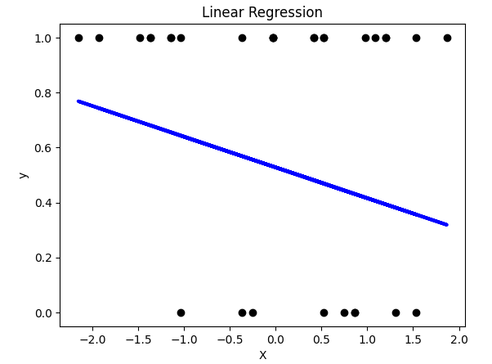

LINEAR REGRESSION
Parameter Name | Purpose | Value
Test size | To split the dataset into training and testing in a ratio | 0.2
Random State | This parameter sets the seed for the random number generator used by the data splitter. By using a fixed seed, the random splitting process becomes deterministic, allowing for result reproducibility. | 3

Slide 3
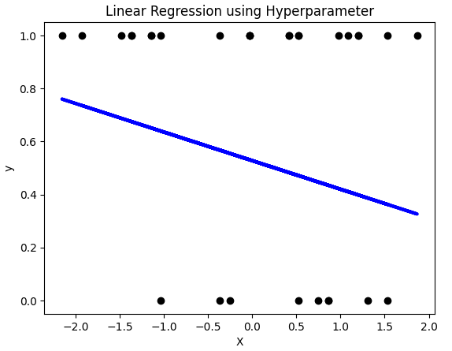

LINEAR REGRESSION WITH HYPERPARAMETER
Parameter Name | Purpose | Value
Test size | To split the dataset into training and testing in a ratio | 0.2
Random State | This parameter sets the seed for the random number generator used by the data splitter. By using a fixed seed, the random splitting process becomes deterministic, allowing for result reproducibility. | 3
Grid Search | The grid search explores various alpha values using 5-fold cross-validation. | 0.001, 0.01, 0.1, 1, 10, 100, 1000
The MSE of the regularized regression model with an alpha = 10 is slightly lower than the MSE of the simple linear regression.
The regularized model performs slightly better in terms of reducing the error.

Slide 4
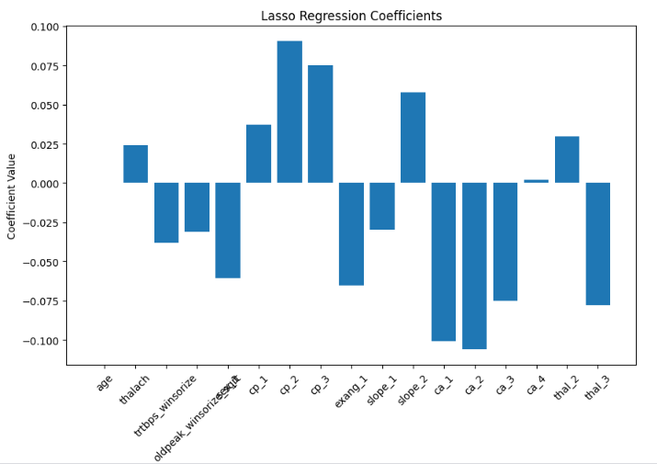
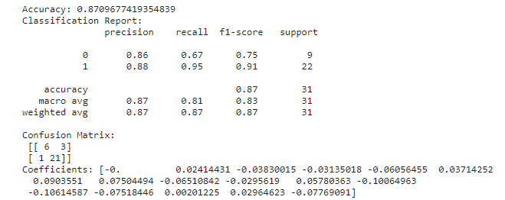
LASSO REGRESSION
Parameter Name | Purpose | Value
Test size | To split the dataset into training and testing in a ratio | 0.2
Random State | This parameter sets the seed for the random number generator used by the data splitter. By using a fixed seed, the random splitting process becomes deterministic, allowing for result reproducibility. | 3
Alpha | The regularization parameter controls the amount of shrinkage applied to the coefficients of the model | 0.01

Slide 5
S.No​ | Performance measure​ | Value​
1​ | Accuracy​ | 0.8709
2​ | Precision​ | 0.87
3​ | Recall (Sensitivity)​ | 0.87​
4​ | Area Under the Curve​ | 99.80​
5​ | F1 Score​ | 0.87
6 | Confusion matrix​ | ​[[ 6 3] [ 1 21]]
The lasso regression model shows good performance overall, with a high accuracy rate. It seems more adept at predicting heart attack than healthy, as evidenced by its higher precision and recall heart attacks. However, there are a few misclassifications, notably in predicting not heart attack where it incorrectly predicted 3 samples as heart attack.

Slide 6
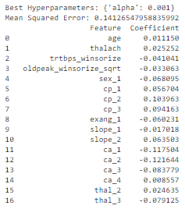
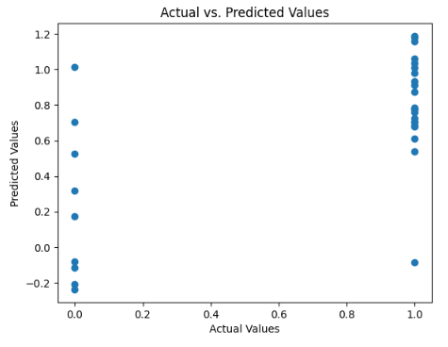
LASSO REGRESSION WITH HYPERPARAMETERS
The Lasso regression model with hyperparameters (specifically, with a smaller alpha value) seems to perform better in terms of MSE, potentially indicating improved generalization and feature importance compared to the model without hyperparameters.

Slide 7
Parameter Name | Purpose | Value
Test size | To split the dataset into training and testing in a ratio | 0.2
Random State | This parameter sets the seed for the random number generator used by the data splitter. By using a fixed seed, the random splitting process becomes deterministic, allowing for result reproducibility. | 3
Alpha | The regularization parameter controls the amount of shrinkage applied to the coefficients of the model | 0.01
Grid Search | The grid search explores various alpha values using 5-fold cross-validation. | [0.001, 0.01, 0.1, 1, 10, 100]

Slide 8
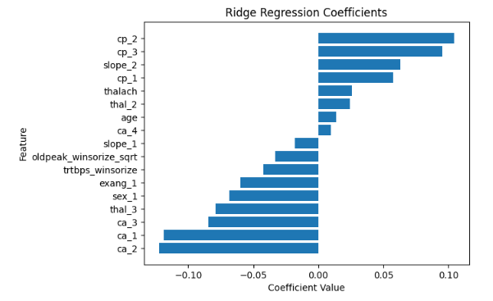
RIDGE REGRESSION
The lower MSE value of 0.1415 indicates a good fit of the ridge regression model to this data.

Slide 9
Parameter Name | Purpose | Value
Test size | To split the dataset into training and testing in a ratio | 0.2
Random State | This parameter sets the seed for the random number generator used by the data splitter. By using a fixed seed, the random splitting process becomes deterministic, allowing for result reproducibility. | 3
Alpha | The regularization parameter controls the amount of shrinkage applied to the coefficients of the model | 1.0

Slide 10
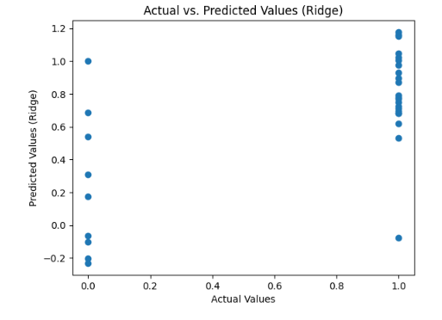

RIDGE REGRESSION WITH
HYPERPARAMETERS
By introducing the alpha hyperparameter and setting it to 10, the model has achieved a lower MSE, indicating potential regularization effects leading to better generalization and reduced overfitting.

Slide 11
Parameter Name | Purpose | Value
Test size | To split the dataset into training and testing in a ratio | 0.2
Random State | This parameter sets the seed for the random number generator used by the data splitter. By using a fixed seed, the random splitting process becomes deterministic, allowing for result reproducibility. | 3
Alpha | The regularization parameter controls the amount of shrinkage applied to the coefficients of the model | 1.0
Grid Search CV | The grid search explores various alpha values using 5-fold cross-validation. | 0.001, 0.01, 0.1, 1, 10, 100, 1000

Slide 12

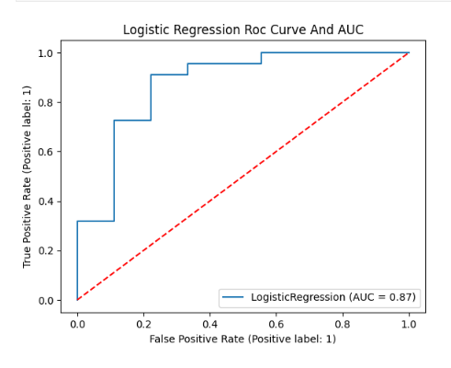
LOGISTIC REGRESSION
Parameter Name | Purpose | Value
Test size | To split the dataset into training and testing in a ratio | 0.2
Random State | This parameter sets the seed for the random number generator used by the data splitter. By using a fixed seed, the random splitting process becomes deterministic, allowing for result reproducibility. | 3
By introducing the alpha hyperparameter and setting it to 10, the model has achieved a lower MSE, indicating potential regularization effects leading to better generalization and reduced overfitting.

Slide 13
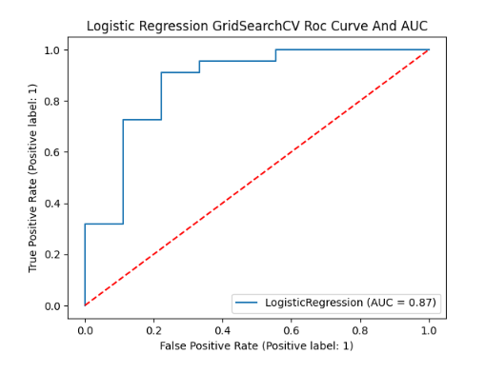
LOGISTIC REGRESSION WITH HYPERPARAMETERS
Parameter Name | Purpose | Value
Test size | To split the dataset into training and testing in a ratio | 0.2
Random State | This parameter sets the seed for the random number generator used by the data splitter. By using a fixed seed, the random splitting process becomes deterministic, allowing for result reproducibility. | 3
Grid Search | The grid search explores various alpha values using 5-fold cross-validation. | "penalty":["l1","l2"], "solver" : ['newton-cg', 'lbfgs', 'liblinear', 'sag', 'saga']

Slide 14
Comparison of Regression Models:
 | Parameter -1 (Test Size) | Parameter -2 (Random State) | Parameter -3 (Alpha) | Parameter -4 (Grid Search CV)
Linear without Hyperparameter | 0.2 | 3 | - | -
Linear with Hyperparameter | 0.2 | 3 | - | 0.001, 0.01, 0.1, 1, 10, 100, 1000
Logistic without Hyperparameter | 0.2 | 3 | - | -
Logistic with Hyperparameter | 0.2 | 3 | 0.01 | "penalty":["l1","l2"], "solver" : ['newton-cg', 'lbfgs', 'liblinear', 'sag', 'saga']
Lasso without Hyperparameter | 0.2 | 3 | 0.01 | -
Lasso with Hyperparameter | 0.2 | 3 | 0.01 | 0.001, 0.01, 0.1, 1, 10, 100, 1000
Ridge without Hyperparameter | 0.2 | 3 | 1.0 | -
Ridge with Hyperparameter | 0.2 | 3 | 1.0 | 0.001, 0.01, 0.1, 1, 10, 100, 1000

Slide 15
CLASSIFIERS

Slide 16
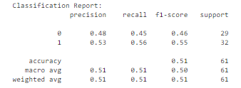
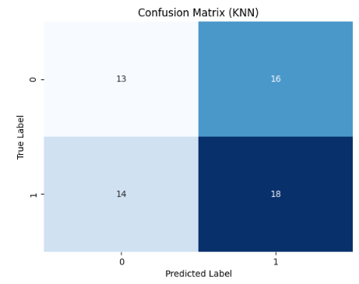
KMEANS WITH KNN
Parameter Name | Purpose | Value
Test size | To split the dataset into training and testing in a ratio | 0.2
Random State | This parameter sets the seed for the random number generator used by the data splitter. By using a fixed seed, the random splitting process becomes deterministic, allowing for result reproducibility. | 42
No. of Clusters | Number of the centroid which will be formed | 2
Grid Search CV | The grid search explores various alpha values using 5-fold cross-validation. | n_neighbors: 3, 5, 7, 9

Slide 17
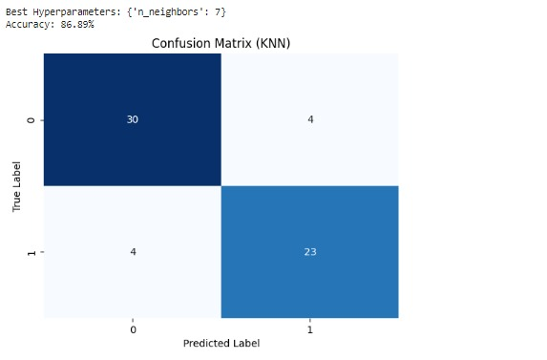
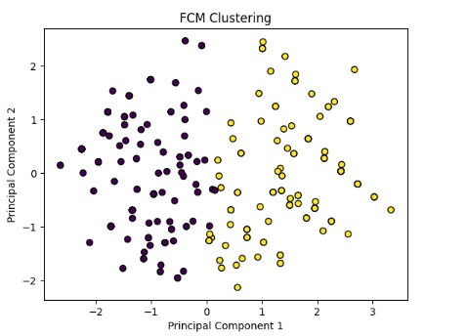
FUZZY C-MEANS WITH KNN USING HYPERPARAMETER
Accuracy: 86.89%

Slide 18
Parameter Name | Purpose | Value
Test size | To split the dataset into training and testing in a ratio | 0.2
Random State | This parameter sets the seed for the random number generator used by the data splitter. By using a fixed seed, the random splitting process becomes deterministic, allowing for result reproducibility. | 5
No. of Clusters | Number of the centroid which will be formed | 2
The fuzziness index or the fuzzifier | controls the degree of fuzziness in the clustering process. The value of "m" determines how much each data point can belong to multiple clusters. | m = 2
Grid Search CV | The grid search explores various alpha values using 5-fold cross-validation. | n_neighbors: 3, 5, 7, 9

Slide 19
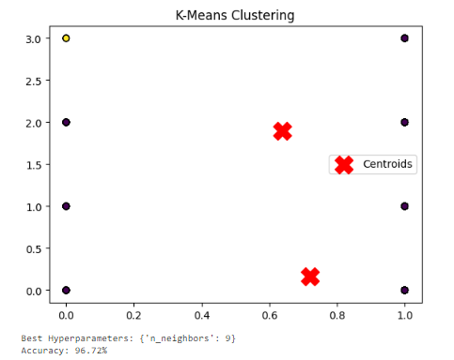
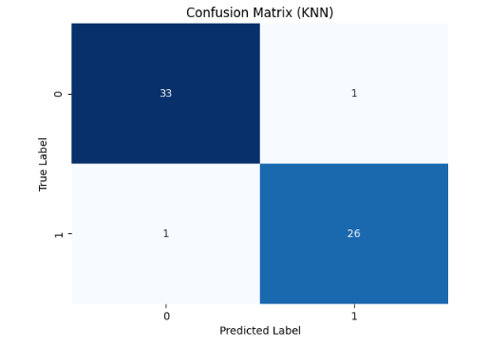

KMEANS WITH KNN WITH HYPERPARAMETERS

Slide 20
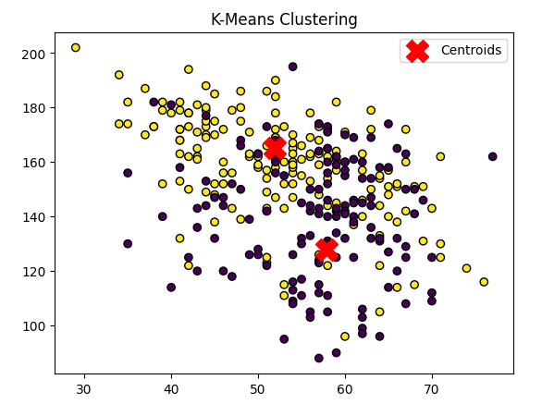
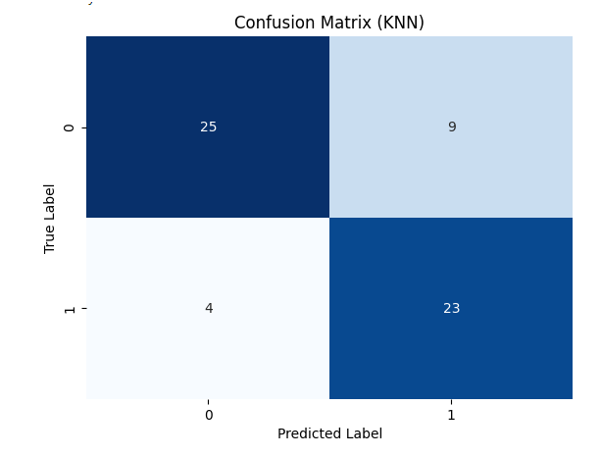

KMEANS WITH KNN WITH HYPERPARAMETERS

Slide 21
The K-Means with KNN model using hyperparameters, specifically setting n_neighbors to 9, shows a significantly higher accuracy of 96.72% compared to the 51% accuracy without hyperparameters.
The confusion matrices for both models depict a considerable improvement in correctly classified instances, especially reducing false positives and false negatives with the tuned hyperparameters.
The precision, recall, and F1-score have improved significantly for both classes with the tuned hyperparameters, considering the marked increase in accuracy and the revised confusion matrix
S.No​ | Performance measure​ | Value​ without Hyperparams | Value with Hyperparams (9 neighbors)
1​ | Accuracy​ | 0.51 | 0.9672
2​ | Precision​ | 0.51 | 0.97
3​ | Recall (Sensitivity)​ | 0.51 | 0.97
4 | F1 Score​ | 0.51 | 0.93
5 | Confusion matrix​ | ​[[ 13 6] [ 14 18]] | [[33 1] [1 26]]

Slide 22
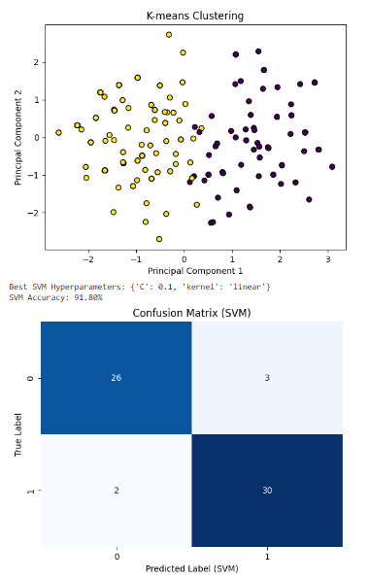
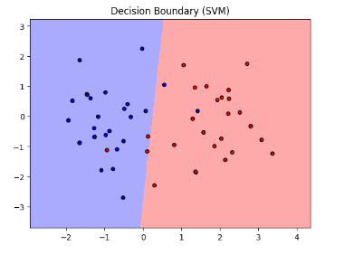
KMEANS WITH SVM WITH HYPERPARAMETERS

Slide 23
Parameter Name | Purpose | Value
Test size | To split the dataset into training and testing in a ratio | 0.2
Random State | This parameter sets the seed for the random number generator used by the data splitter. By using a fixed seed, the random splitting process becomes deterministic, allowing for result reproducibility. | 42
Kernel | kernel is a function that computes the dot product of two data points in a transformed feature space. | Linear
Cross-validation | The purpose of cross-validation is to evaluate the model's performance for different combinations of hyperparameters. | 5
Grid Search CV | The grid search explores various alpha values using 5-fold cross-validation. | 0.1, 1, 10

Slide 24
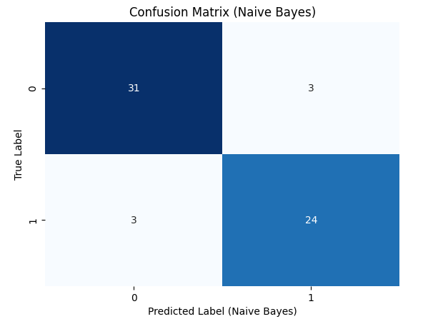
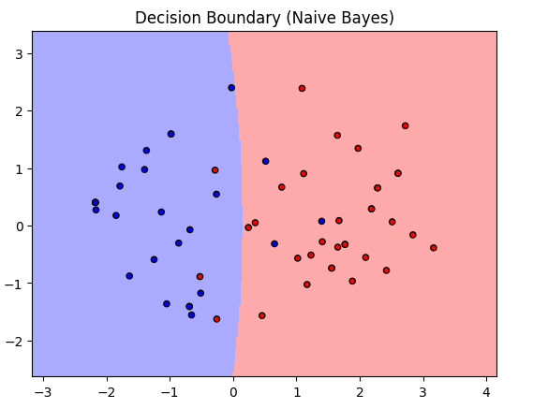

NAIVE BAYES CLASSIFIER

Slide 25
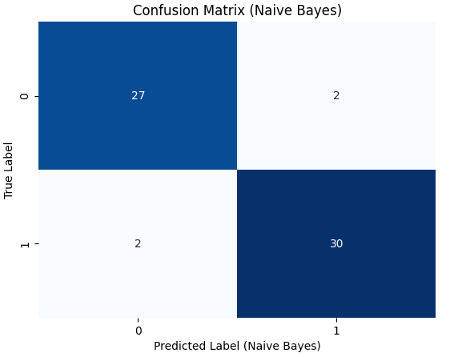
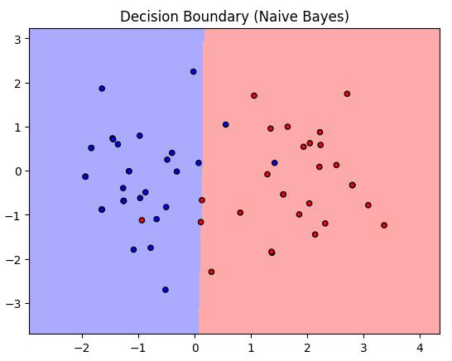

NAIVE BAYES CLASSIFIER WITH HYPERPARAMETERS

Slide 26
Parameter Name | Purpose | Value
Test size | To split the dataset into training and testing in a ratio | 0.2
Random State | This parameter sets the seed for the random number generator used by the data splitter. By using a fixed seed, the random splitting process becomes deterministic, allowing for result reproducibility. | 42
Grid Search CV | The grid search explores various alpha values using 5-fold cross-validation. | np.logspace(0, -9, num=100)

Slide 27
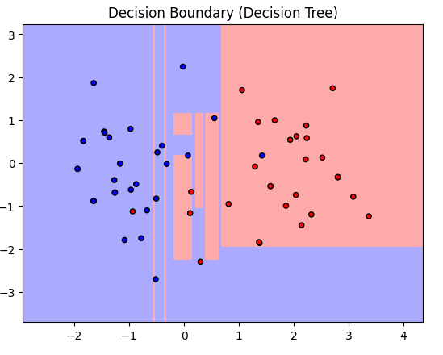
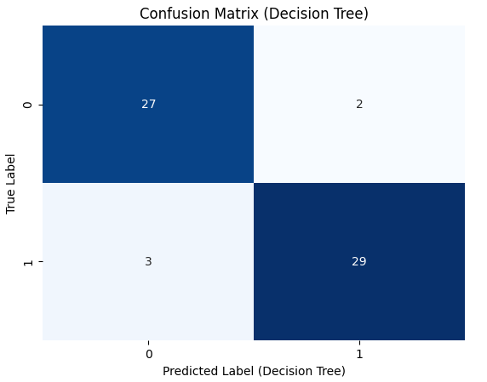
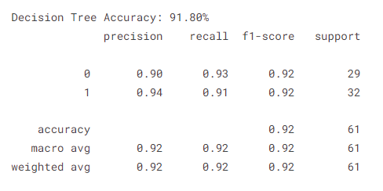
DECISION TREE

Slide 28
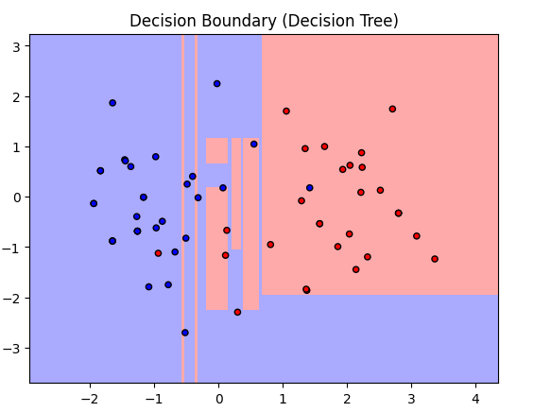
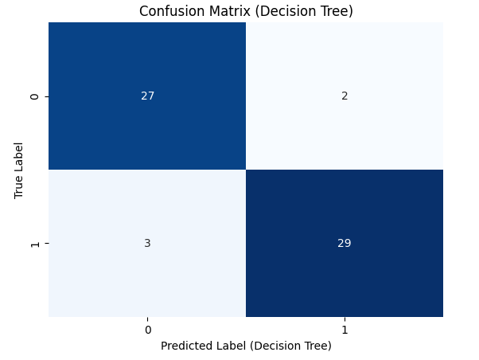
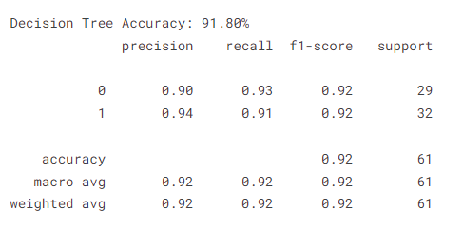
DECISION TREE WITH HYPERPARAMETERS

Slide 29
Parameter Name | Purpose | Value
Test size | To split the dataset into training and testing in a ratio | 0.2
Random State | This parameter sets the seed for the random number generator used by the data splitter. By using a fixed seed, the random splitting process becomes deterministic, allowing for result reproducibility. | 42
Grid Search CV | The grid search explores various alpha values using 5-fold cross-validation. | 'criterion': ['gini', 'entropy'], 'max_depth': [None, 10, 20, 30, 40, 50], 'min_samples_split': [2, 5, 10], 'min_samples_leaf': [1, 2, 4]

Slide 30
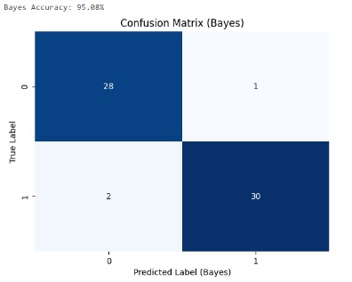
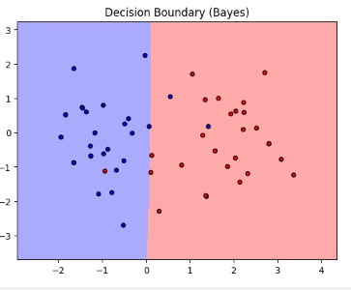
BAYESIAN CLASSIFIER
Bayesian accuracy: 95.6%

Slide 31
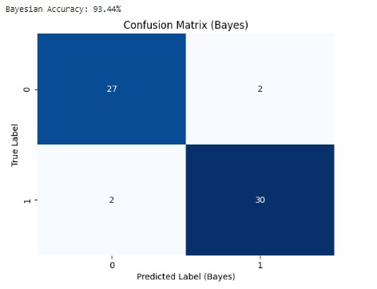
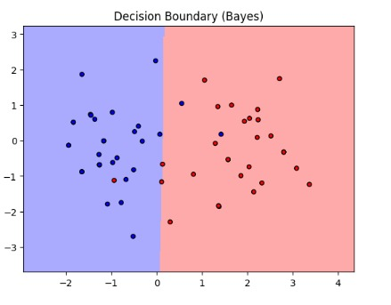
BAYESIAN CLASSIFIER WITH HYPERPARAMETER
Bayesian accuracy: 93.44%

Slide 32
Parameter Name | Purpose | Value
Test size | To split the dataset into training and testing in a ratio | 0.2
Random State | This parameter sets the seed for the random number generator used by the data splitter. By using a fixed seed, the random splitting process becomes deterministic, allowing for result reproducibility. | 42
Grid Search CV | The grid search explores various alpha values using 5-fold cross-validation. | np.logspace(0, -9, num=100)

Slide 33
Comparision classifier table:
Sr. No. | Algorithm name | Test Size | Random State | Grid Search CV | Accuracy
1 | KMeans with KNN | 0.2 | 42 | n_neighbors: 3, 5, 7, 9 | 96.72%
2 | Fuzzy C-Means with KNN | 0.2 | 5 | n_neighbors: 3, 5, 7, 9 | 86.89%
3 | KMeans with SVM | 0.2 | 42 | 0.1, 1, 10 | 91.80%
4 | Bayesian Classifier | 0.2 | 42 | np.logspace(0, -9, num=100) | 93.44%
5 | Naïve Bayes Classifier | 0.2 | 42 | np.logspace(0, -9, num=100) | 90.16%
6 | Decision Tree | 0.2 | 42 | 'criterion': ['gini', 'entropy'], 'max_depth': [None, 10, 20, 30, 40, 50], 'min_samples_split': [2, 5, 10], 'min_samples_leaf': [1, 2, 4] | 91.80%

Slide 34
DEEP LEARNING

Slide 35
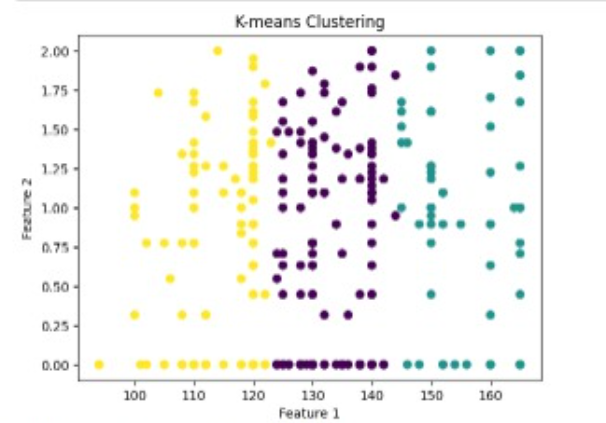
KMEANS WITH CNN
S.No​ | Performance measure​ | Cluster 0 | Cluster 1 | Cluster 2
1​ | Accuracy​ | 0.5458 | 0.5833 | 0.623
2​ | Precision​ | 0.546 | 0.00 | 0.623
3​ | Recall (Sensitivity)​ | 1.0 | 0.00 | 1.00
4 | F1 Score​ | 0.701 | 0.00 | 0.76
5 | Confusion matrix​ | ​[[0 64] [0 77]] | [[35 0] [25 0]] | [[0 38] [0 63]]

Slide 36
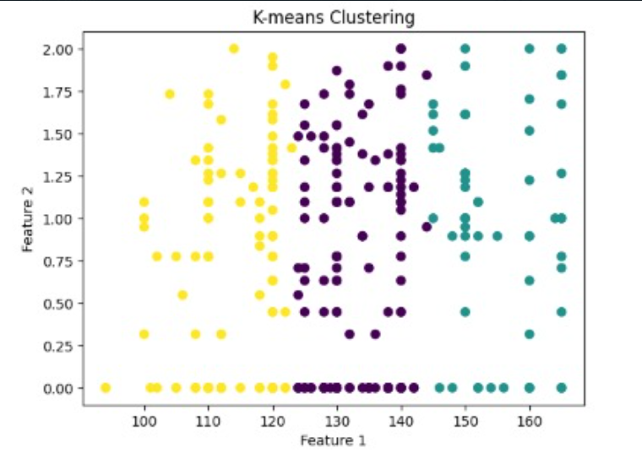
KMEANS WITH CNN
WITH HYPERPARAMETERS
S.No​ | Performance measure​ | Cluster 0 | Cluster 1 | Cluster 2
0 | CNN Dense units | 32 | 64 | 32
1​ | CNN Filter size | 16 | 64 | 16
2​ | CNN Kernel Size | 2 | 2 | 2
3​ | CNN Accuracy​ | 0.45 | 0.5833 | 0.62
4 | CNN Precision​ | 0.00 | 0.00 | 0.62
5 | CNN Recall (Sensitivity)​ | 0.00 | 0.00 | 1.0
6 | CNN F1 Score​ | 0.00 | 0.00 | 0.768
7 | CNN Confusion matrix​ | ​[[64 0] [ 77 0]] | [[35 0] [25 0]] | [[0 38] [0 63]]
8 | N neighbors | 3 | 3 | 11
9 | KNN Accuracy​ | 0.765 | 0.6833 | 0.7623
10 | KNN Precision​ | 0.7619 | 0.6363 | 0.842
11 | KNN Recall (Sensitivity)​ | 0.8311 | 0.56 | 0.7619
12 | KNN F1 Score​ | 0.796 | 0.5957 | 0.8
13 | KNN Confusion matrix​ | ​[[44 20] [ 13 64]] | [[27 8] [11 14]] | [[29 9] [15 48]]

Slide 37
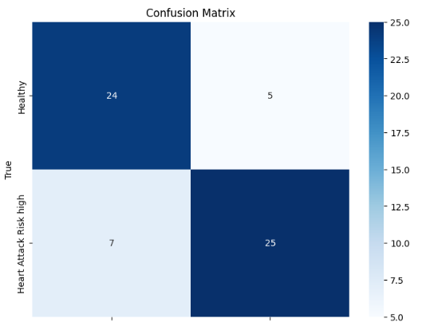
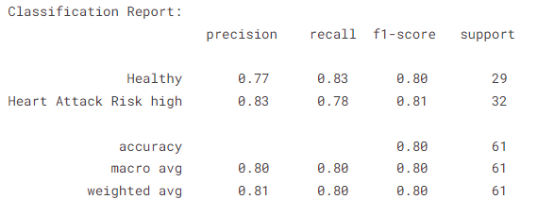

ALEXNET
Healthy
Predicted
Heart attack risk

Slide 38
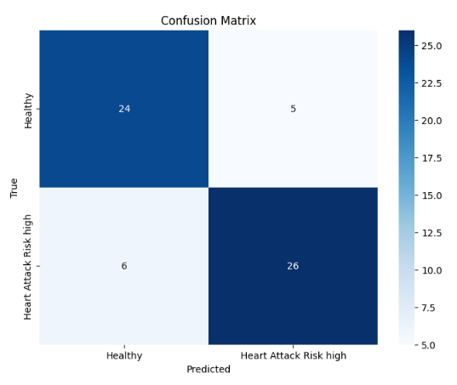
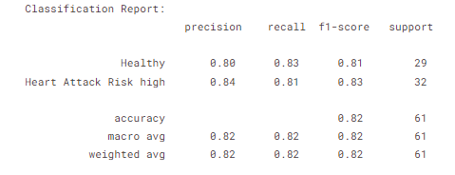
ALEXNET WITH HYPERPARAMETERS

Slide 39
 | Parameters | Value
1 | Epochs | 100
2 | Accuracy | 96.35%
3 | Training Loss | 0.0962
4 | Validation Accuracy | 77.55%
5 | Validation Loss | 0.8015
6 | Testing Accuracy | 80.33%
7 | Batch Size | 64
8 | Learning Rate | 0.001
9 | Dropout | 0.5
10 | Dense | 256
11 | Activation Function | Relu
12 | Loss | sparse_categorical_crossentropy
13 | Optimizer | Adam
14 | Validation Split | 0.2
15 | Test size | 0.2
16 | Confusion matrix | [[24 5] [ 7 25]]

Slide 40
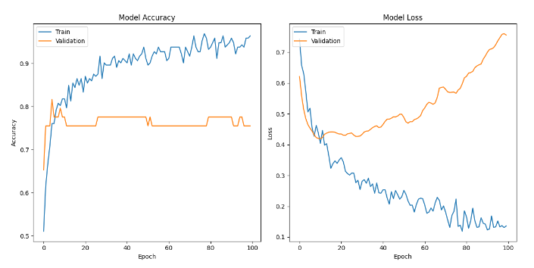
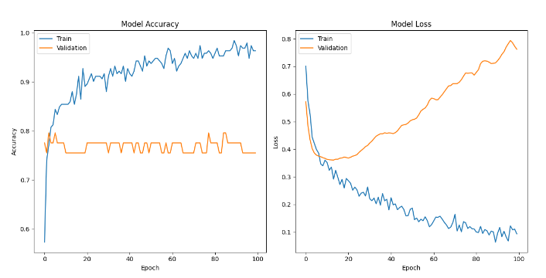
Without
hyper
K-Means clustering combined with KNN, utilizing the tuned hyperparameter (n_neighbors=9), demonstrates a substantially better performance, yielding higher accuracy and more reliable classification
With hyper

Slide 41
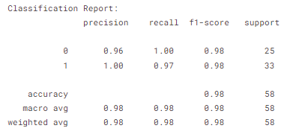
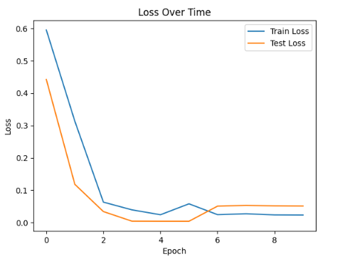
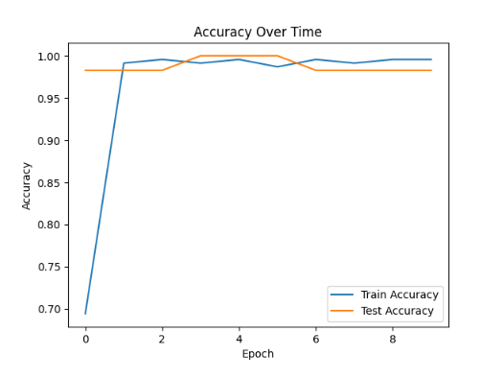
LSTM

Slide 42
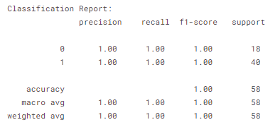
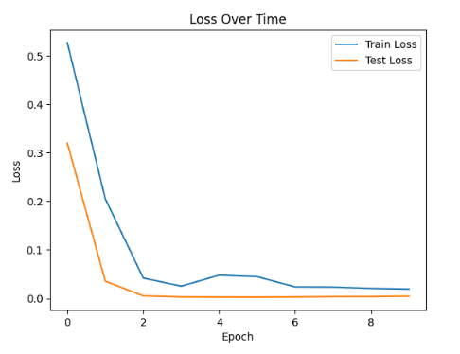
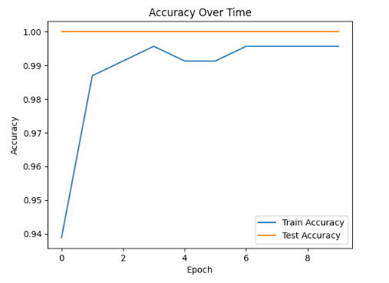
LSTM WITH HYPERPARAMETERS

Slide 43
Sr. No. | Parameters | Value
1 | Epochs | 10
2 | Accuracy | 99.56%
3 | Training Loss | 0.0228
4 | Validation Accuracy | 98.28%
5 | Validation Loss | 0.0597
6 | Testing Accuracy | 98.3275%
7 | Batch Size | 32
8 | Loss | binary_crossentropy
9 | Optimizer | adam
10 | Activation Function | Sigmoid
11 | LSTM Unit | 100
12 | Learning rate | 0.001
13 | Test size | 0.2
14 | Precision, recall, f1-score | 0.98,0.98,0.98
15 | LSTM Units | 100

Slide 44
S.No​ | Performance measure​ | Value​ without Hyperparams | Value with Hyperparams (9 neighbors)
1​ | Accuracy​ | 0.98 | 1.00
2​ | Precision​ | 0.98 | 1.00
3​ | Recall (Sensitivity)​ | 0.98 | 1.00
4 | F1 Score​ | 0.97 | 1.00
Adding hyperparameters seems to have further optimized the LSTM model, achieving a perfect accuracy of 100% compared to the 98.28% accuracy without specific hyperparameters.
Both models perform exceedingly well, showing near-perfect classification across both classes, demonstrating their robustness in capturing patterns and making accurate predictions on the given dataset.

Slide 45
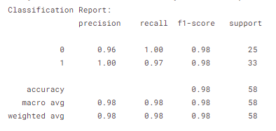
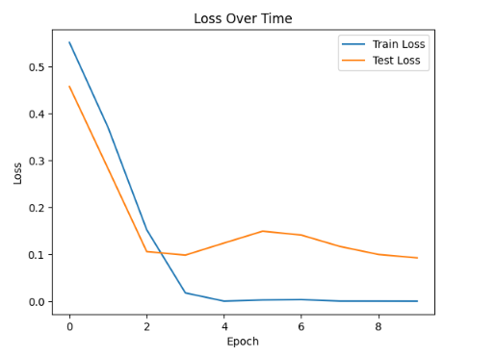

GRU

Slide 46



GRU WITH HYPERPARAMETERS

Slide 47
Sr. No. | Parameters | Value
1 | Epochs | 20
2 | Accuracy | 100.00%
3 | Training Loss | 0.000134
4 | Validation Accuracy | 98.28%
5 | Validation Loss | 0.1243
6 | Testing Accuracy | 98.2758%
7 | Test Loss | 0.124257
8 | Batch Size | 32
9 | Loss | binary_crossentropy
10 | Optimizer | adam
11 | Activation Function | Sigmoid
12 | GRU Unit | 100
13 | Learning rate | 0.001
14 | Test size | 0.2
15 | Gru Units | 100
16 | Precision, recall, f1-score | 0.98, 0.98, 0.98

Slide 48
S.No​ | Performance measure​ | Value​ without Hyperparams | Value with Hyperparams (9 neighbors)
1​ | Accuracy​ | 0.98 | 1.00
2​ | Precision​ | 0.98 | 1.00
3​ | Recall (Sensitivity)​ | 0.98 | 1.00
4 | F1 Score​ | 0.97 | 1.00
Incorporating hyperparameters appears to have further optimized the GRU model, achieving a perfect accuracy of 100% compared to the 98.28% accuracy without specific hyperparameters.
Both models demonstrate robustness and accuracy in their predictions, showcasing their proficiency in capturing patterns and making precise predictions on the provided dataset.

Slide 49

Thank you

